Slide 1

HEART DISEASE IDENTIFICATION METHOD USING MACHINE LEARNING CLASSIFICATION IN E-HEALTHCARE
DEPARTMENT OF COMPUTER SCIENCE AND ENGINEERING
TEAM MEMBERS GUIDE
1. JAYANT H – 113319104032 Mr. J.A.JEVIN, M.E.,
2. SANJAY R– 113319104074
3. HEMASAI V – 113319104097
4.VENKATASRINIVAS P V – 113319104103

Slide 2
ABSTRACT
The proposed methodology and algorithm for mining distributed medical data sources using Association Rules is a promising approach to improving healthcare outcomes while preserving the privacy and security of patient data.
This approach uses agents to represent each distributed data source and perform local tasks, minimizing communication and travel across the network.
The use of Association Rules can provide valuable insights into patient care and treatment planning, but the quality of results may depend on the completeness and accuracy of the data.
Overall, this approach shows potential for addressing the limitations of centralized EHRs

Slide 3
INTRODUCTION
The use of computer technologies in healthcare has increased in recent years, with machine learning becoming an important solution for aiding the diagnosis of patients.
However, the high dimensionality of medical datasets poses a challenge for machine learning algorithms, leading to overfitting and reduced performance.
Feature extraction and selection techniques can help overcome this challenge by simplifying and reducing the dataset while identifying important features.
This presentation explores the use of machine learning and feature selection techniques for improving medical diagnosis and patient care.

Slide 4
LITERATURE SURVEY

Slide 5
REFERENCE PAPER | TITLE | AUTHORS | PUBLICATION YEAR
1 | Efficient Prediction of Cardiovascular Disease Using Machine Learning Algorithms With Relief and LASSO Feature Selection Techniques | Pronab Ghosh1, Sami Azam, Mirjam Jonkman, Asif Karim, F. M. Javed Mehedi Hamrat, Eva Ignatious, Shahana Shultana, Abhijith Reddy Beeravolu, and Friso de boer | 2021
2 | Deep Ensemble Detection of Congestive Heart Failure Using Short-Term RR Intervals | Ludi Wang , Wei Zhou, Qing Chang, Jiangen Chen, And Xiaoguang Zhou1. | 2019
3 | Machine Learning Techniques For Heart Disease Prediction | A. Lakshmanarao,Y.Swathi, P.Sri Sai Sundareswar | 2019
4 | Heart Disease Detection Using Machine Learning Majority Voting Ensemble Method | Rahma Atallah, Amjed Al-Mousa | 2019

Slide 6
SYSTEM CONFIGURATION
H/W SYSTEM CONFIGURATION:
Processor - I3,I5,I7
Speed - 1.1 GHz
RAM - 8 Gb
Hard Disk - 500 GB
S/W SYSTEM CONFIGURATION:
Operating System - Windows 7/8/10
Front End - Html ,Css
Scripts - Python language
Tool - Python IDE

Slide 7
EXISTING SYSTEM
The need for algorithms that allow databases to remain at their individual sites while still being able to work together is desirable.
However, this presents a common constraint where data cannot be moved to other sites due to security, privacy, and data ownership reasons.
Medical data is a prime example of naturally distributed data, where each organization owns their own database and cannot share data with other organizations.
These constraints require algorithms that can perform localized computations on each database, allowing for data analysis while maintaining data privacy and ownership.

Slide 8
DISADVANTAGE
These information systems are segregated on the basis of the type of data stored and where they are used. They work separately from each other, because they are localized stand-alone systems.
In order to improve the quality of healthcare services by granting shared access to data, healthcare systems are opting for the integration of data sources

Slide 9
PROPOSED SYSTEM
This paper proposes a new methodology and algorithm to mine distributed medical data sources using Association Rules.
The data sources are located at different sites and cannot be moved, so the computation must be decomposed into local computations.
Each data source is represented by an agent, and the global computation is performed by exchanging minimal summaries or by agents traveling to each site and performing local tasks.
The proposed methodology can handle different data distributions and participating nodes in each instance of the computation.

Slide 10
ADVANTAGE
The advantages of EHRs in disease diagnosis and prediction, they are still not widely adopted by physicians
The barriers that restrain physicians from using EHRs is main advantage.

Slide 11
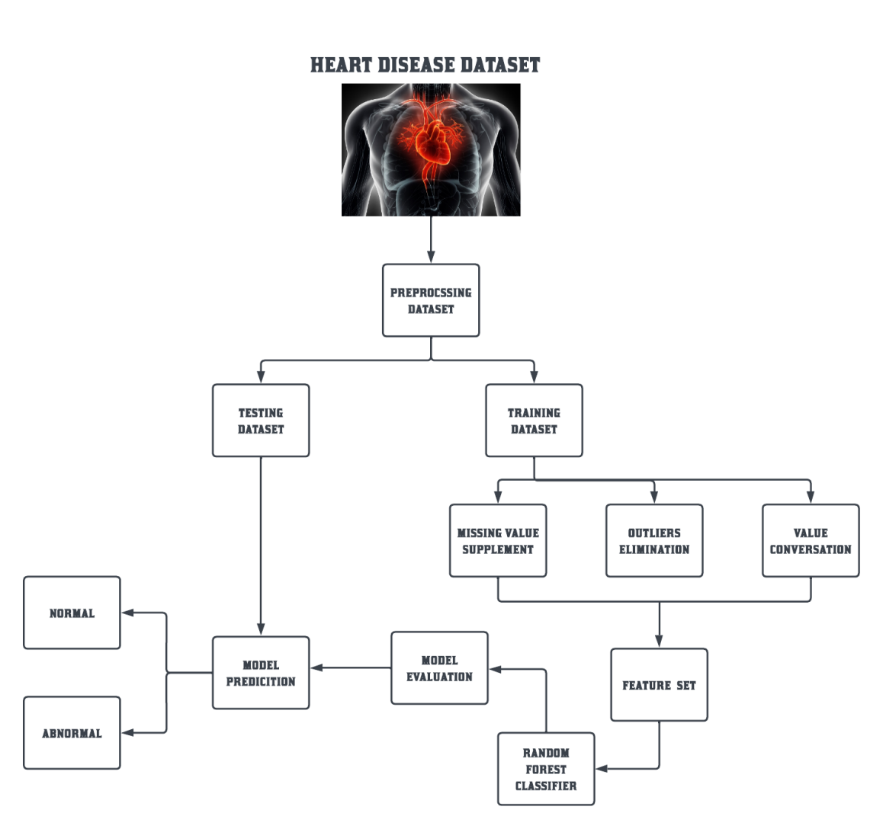
ARCHITECTURE DIAGRAM

Slide 12
MODULES DISCRIPTION
MODULES LIST:
Data pre-processing
Feature selection and reduction
Classification model
Discussion of HRFLM to improve the results

Slide 13
DATA PRE-PROCESSING:
The pre-processed Heart disease dataset contains patient records, where missing values have been removed.
The dataset uses a multiclass variable and binary classification to check the presence or absence of heart disease.
The multiclass variable is set to 1 when the patient has heart disease and 0 when there is no heart disease.
During the pre-processing of data, medical records were converted into diagnosis values. The dataset contains a total of patient records, where records indicate the presence of heart disease while the remaining records indicate the absence of heart disease.
The pre-processing of data helps in identifying the patterns and relationships between different attributes and can be used to develop predictive models for heart disease.

Slide 14
FEATURE SELECTION AND REDUCTION:
The results showed that the accuracy of the classification was higher when age and sex attributes were excluded from the input features.
This indicates that including personal information of the patient in the input features can negatively affect the accuracy of the classification.
Therefore, it is important to carefully consider the use of personal information in the analysis of medical data to ensure privacy and accuracy.
Additionally, it is crucial to comply with ethical guidelines and regulations in the handling of medical data.

Slide 15
CLASSIFICATION MODEL:
Clustering of datasets involves grouping similar instances together based on their attributes or features.
In this case, the clustering is done using the variables and criteria of Random Forest (RF) features. After clustering, classifiers are applied to each clustered dataset to estimate their performance.
The best performing models are identified based on their low error rate.
To further optimize performance, the Random Forest cluster with a high error rate is chosen and its corresponding classifier features are extracted.
These features are then used to evaluate the performance of the classifier for error optimization on this particular dataset.
This process aims to improve the accuracy of the classifier on the specific data set by identifying the most relevant features for that particular dataset.

Slide 16
DISCUSSION OF HRFLM TO IMPROVE THE RESULTS:
A dataset from UCI has been classified into 8 types of datasets based on classification rules.
Then, R Studio Rattle was used to further process and classify each dataset based on the generated classification rules.
After data pre-processing, the three best machine learning techniques were selected and applied to each dataset to determine the best classification method.
The results showed that Random Forest (RF) and Linear Model (LM) were the best methods.
For example, dataset 4 had a higher RF rate (20.9%) compared to the other datasets, while LM method was the best (9.1%) compared to DT and RF methods.

Slide 17
CODING
from flask import Flask, render_template, request
import pickle
import numpy as np
filename = 'heart.pkl'
model = pickle.load(open(filename, 'rb'))
app = Flask(__name__)
@app.route('/')
def home():
return render_template('main.html')
@app.route('/predict', methods=['GET','POST'])
def predict():

Slide 18
if request.method == 'POST':
age = int(request.form['age'])
sex = request.form.get('sex')
cp = request.form.get('cp')
trestbps = int(request.form['trestbps'])
chol = int(request.form['chol'])
fbs = request.form.get('fbs’)
restecg = int(request.form['restecg'])
thalach = int(request.form['thalach'])
exang = request.form.get('exang')
oldpeak = float(request.form['oldpeak'])
return render_template('result.html', prediction=my_prediction)

Slide 19
slope = request.form.get('slope')
ca = int(request.form['ca'])
thal = request.form.get('thal')
data=np.array([[age,sex,cp,trestbps,chol,fbs,restecg,thalach,exang,oldpeak,slope,ca,thal]])
my_prediction = model.predict(data)
if __name__ == '__main__':
app.run(debug=True)

Slide 20
FEATURE ENCHANCEMENT
Later on, we will utilize different highlights determination calculations, improvement strategies to additional expansion the exhibition of a prescient framework for HD conclusion.
The controlling and treatment of infection is importance after determination, subsequently, I will chip away at treatment and recuperation of infections in future likewise for basic sickness, for example, heart, bosom, Parkinson, diabetes.

Slide 21
REFERENCE
[1] S. J. Pasha and e. S. Mohamed, ‘‘novel feature reduction (nfr) model with machine learning and data mining algorithms for effective disease risk prediction,’’ ieee access, vol. 8, pp. 184087–184108, 2020.
[2] Y. Khan, U. Qamar, N. Yousaf, and A. Khan, ‘‘Machine learning techniques for heart disease datasets: A survey,’’ in Proc. 11th Int. Conf. Mach. Learn. Comput. (ICMLC), Zhuhai, China, 2019, pp. 27–35.
[3] S. Goel, A. Deep, S. Srivastava, and A. Tripathi, ‘‘Comparative anal- ysis of various techniques for heart disease prediction,’’ in Proc. 4th Int. Conf. Inf. Syst. Comput. Netw. (ISCON), Mathura, India, Nov. 2019, pp. 88–94

Slide 22
[4] A. Lakshmanarao, Y. Swathi, and P. S. S. Sundareswar, ‘‘Machine learning techniques for heart disease prediction,’’ Int. J. Sci. Technol. Res., vol. 8, no. 11, p. 97, Nov. 2019.
[5] S. Mohan, C. Thirumalai, and G. Srivastava, ‘‘Effective heart disease prediction using hybrid machine learning techniques,’’ IEEE Access, vol. 7,pp. 81542–81554, 2019.
[6] A. K. Gárate-Escamila, A. Hajjam El Hassani, and E. Andrès, ‘‘Classification models for heart disease prediction using feature selection and PCA,’’ Informat. Med. Unlocked, vol. 19, Jan. 2020, Art. no. 100330.
[7] D. W. Hosmer, S. Lemeshow, and E. D. Cook, Applied Logistic Regression, 2nd ed. New York, NY, USA: Wiley, 2000.

Slide 23
[8] E. Nasarian, M. Abdar, M. A. Fahami, R. Alizadehsani, S. Hussain, M. E. Basiri, M. Zomorodi-Moghadam, X. Zhou, P. Pławiak, U. R. Acharya, R.-S. Tan, and N. Sarrafzadegan, ‘‘Association between work-related features and coronary artery disease: A heterogeneous hybrid feature selection integrated with balancing approach,’’ Pattern Recognit. Lett., vol. 133, pp. 33–40, May 2020
[9] R. Atallah and A. Al-Mousa, ‘‘Heart disease detection using machine learning majority voting ensemble method,’’ in Proc. 2nd Int. Conf. new Trends Comput. Sci. (ICTCS), Oct. 2019, pp. 1–6.
[10] A. Gupta, L. Kumar, R. Jain, and P. Nagrath, ‘‘Heart disease pre-diction using classification (naive bayes),’’ in Proc. 1st Int. Conf. Comput., Commun., Cyber-Secur. (ICS). Singapore: Springer, 2020, pp. 561–573.

Slide 24
MOTIVATION OF PROJECT
The main motivation of doing this research is to present a heart disease prediction model for the prediction of occurrence of heart disease.
Further, this research work is aimed towards identifying the best classification algorithm for identifying the possibility of heart disease in a patient.

Slide 25
THANK YOU !

